Slide 1

Jenkins
Shared Library

Slide 2
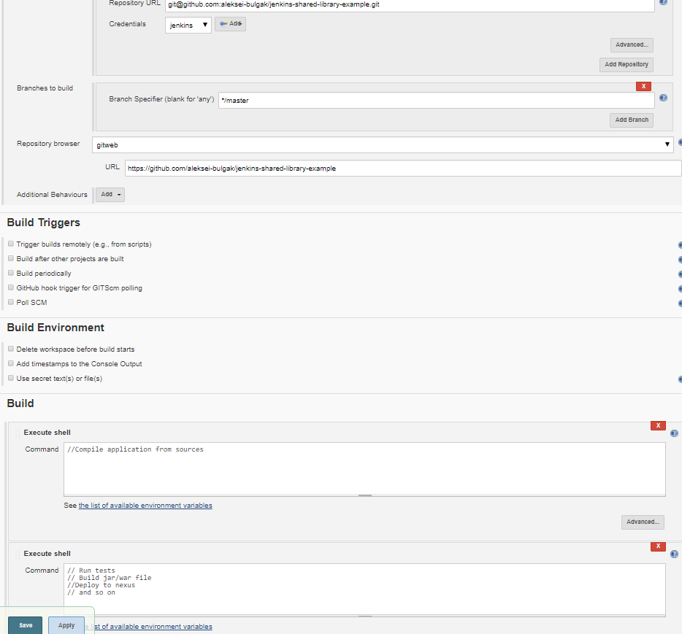

Before Jenkins 2
Manually configure job via jenkins UI (Freestyle job)

Slide 3
Pluses
Minuses
Easy to create for everybody(dev, qa, manager)
Easy to add changes any time
In almost all cases each available component accessible from UI should work as described in docs
Hard to automate job recreation
Bash scripting

Slide 4
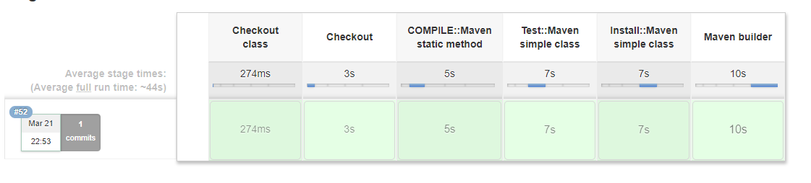

Jenkins 2
Pipelines
pipeline { agent any stages { stage('Build') { steps { echo 'Building..' } } stage('Test') { steps { echo 'Testing..' } } stage('Deploy') { steps { echo 'Deploying....' } } } }

Slide 5
Pluses
Minuses
Easy to automate job recreation
Programmatic way of job creation
In almost all cases each available component accessible from UI should work as described in docs
Scripts syntax depends on version of pipeline library
Not a Groovy

Slide 6


Backoffice
Proxy service
RMS
One big app
Jobs
Jobseeker jobs
ESS
Document storage
Problem overview

Slide 7





Shared library
Shared library
Shared library
Shared library

Slide 8
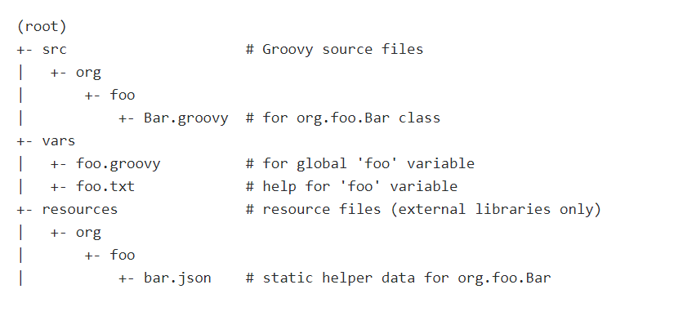
Structure

Slide 9
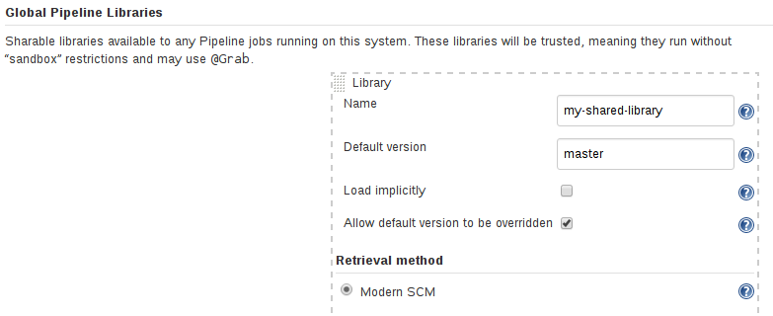
Import library
@Library('somelib') import com.mycorp.pipeline.somelib.UsefulClass
library('my-shared-library').com.mycorp.pipeline.Utils.someStaticMethod()
vars/
src/
До сих пор не понял как это работает
@Library('my-shared-library') _ /* Using a version specifier, such as branch, tag, etc */ @Library('my-shared-library@1.0') _ /* Accessing multiple libraries with one statement */ @Library(['my-shared-library', 'otherlib@abc1234']) _
library 'my-shared-library'

Slide 10

DEMO 01/02
jenkins

Slide 11

@Library
library
Libraries are resolved and loaded during compilation of the script, before it starts executing
Use @Library('lib-name@version') _ if your lib contains only var functions
Dynamically loaded
You cannot import or otherwise “statically” refer to types from the library

Slide 12
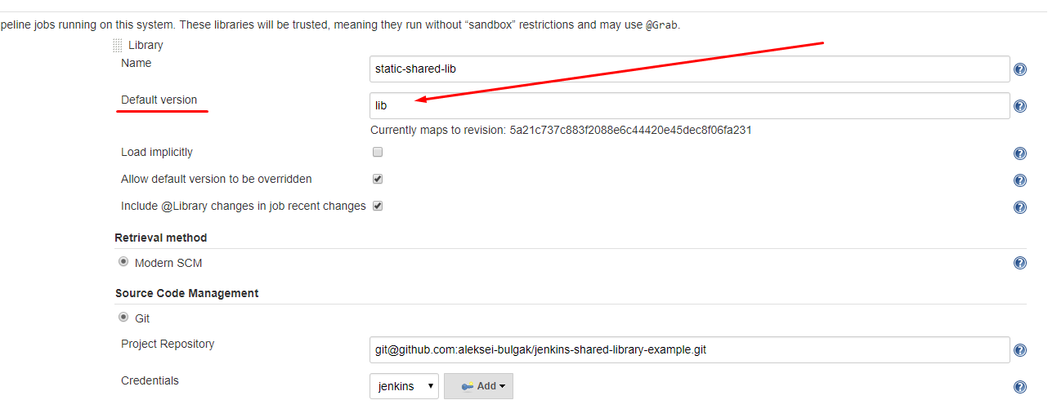
Versions
@Library('my-shared-library') _ -> default version
@Library('my-shared-library@$BRANCH_NAME') _ -> $BRANCH_NAME version
library "my-shared-library" -> default version
library "my-shared-library@$BRANCH_NAME" -> $BRANCH_NAME version

Slide 13
DEMO 03
jenkins

Slide 14

Src/
package org.foo class Utilities implements Serializable { def steps Utilities(steps) {this.steps = steps} def mvn(args) { steps.sh "${steps.tool 'Maven'}/bin/mvn -o ${args}" } }
def utils = library('utils')org.foo.Utilities node { utils.new(this).mvn('clean package') }
package org.foo
def mvn(args) { sh "${tool 'Maven'}/bin/mvn -o ${args}" }
def utils = library('utils')org.foo.Utilities
node { utils.new().mvn('clean package') }

Slide 15
DEMO 04
simple-lib

Slide 16
vars/
vars/log.groovy
def info(message) { echo "INFO: ${message}" } def warning(message) { echo "WARNING: ${message}" }
Multiple functions in one file

Slide 17
DEMO 05

Slide 18
DEMO 06
temp

Slide 19

Conclusion
Not a silver bullet
Some features works strange
Hard to debug if you do not have groovy sdk
You can cover such libs with tests(even with integration tests)
This is not actually a Groovy and as a result we do not have access to some cool Groovy features
But you can inject external libs and code via @Grab('groupId:artifactId:version')

Slide 20

References
https://jenkins.io/doc/book/pipeline/shared-libraries/
https://github.com/fabric8io/fabric8-jenkinsfile-library
https://github.com/fabric8io/fabric8-pipeline-library

